Slide 1
Wireless Communications:
Principles and Practice
2nd Edition
T.S. Rappaport
Chapter 7: Equalization, Diversity, and Channel Coding

Slide 2
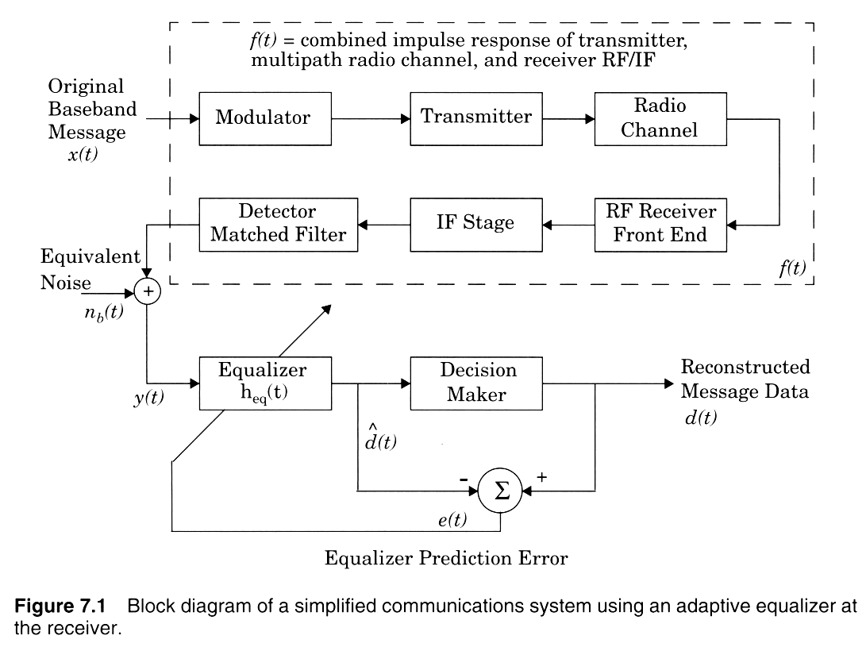

Slide 3
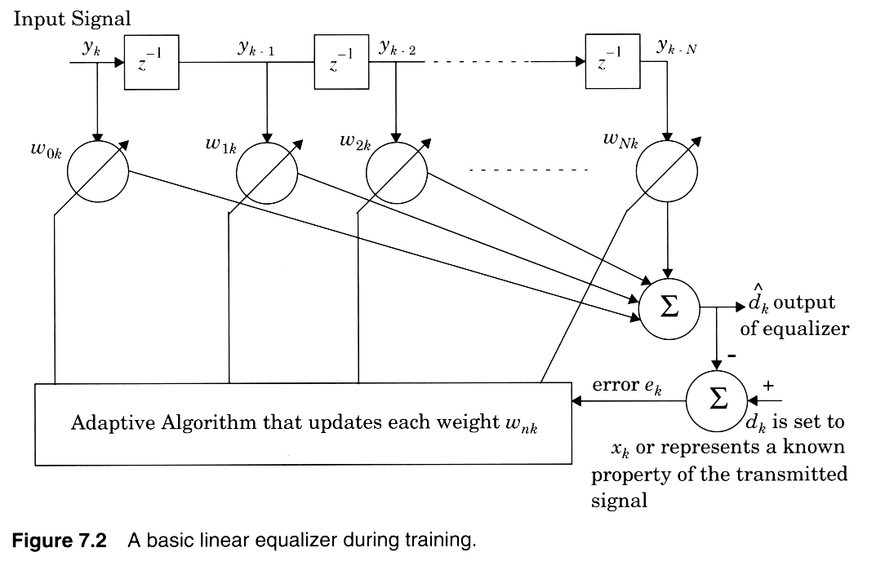
Notes:
Fig. 3.2

Slide 4
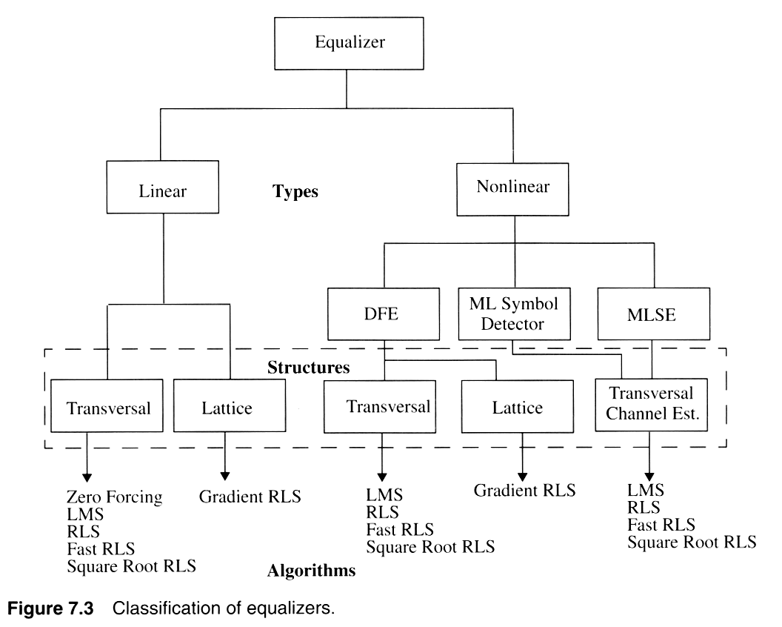

Slide 5
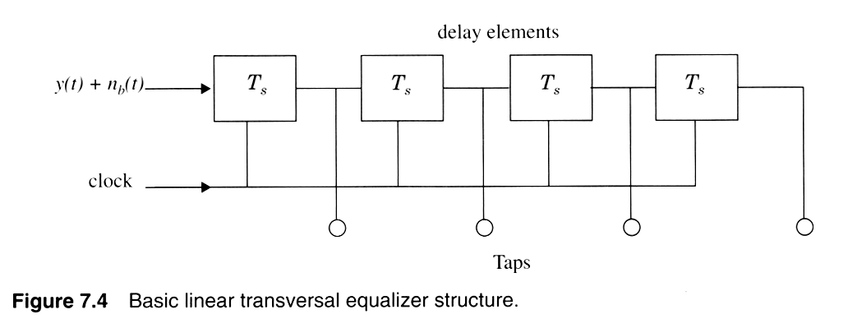
Notes:
Fig. 2.3

Slide 6
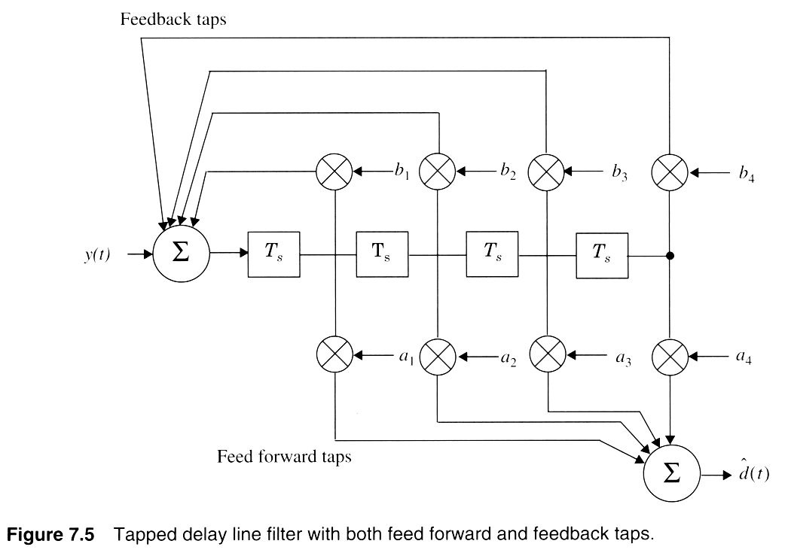

Slide 7
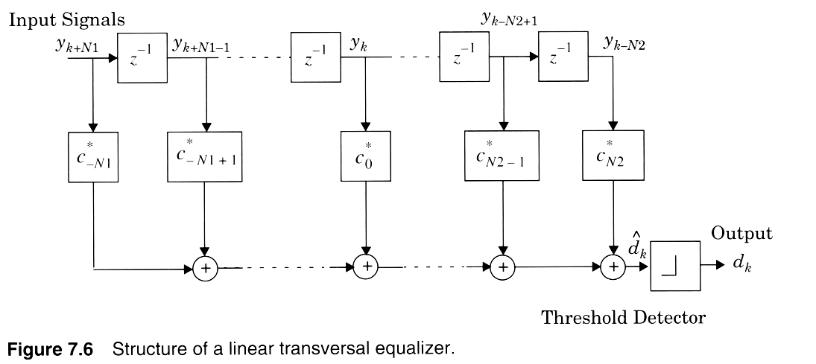

Slide 8
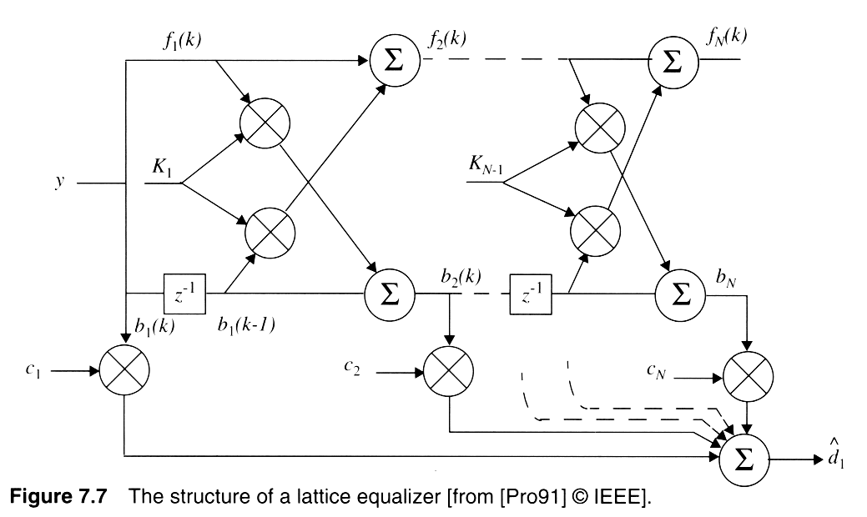
Notes:
Fig. 2.4

Slide 9
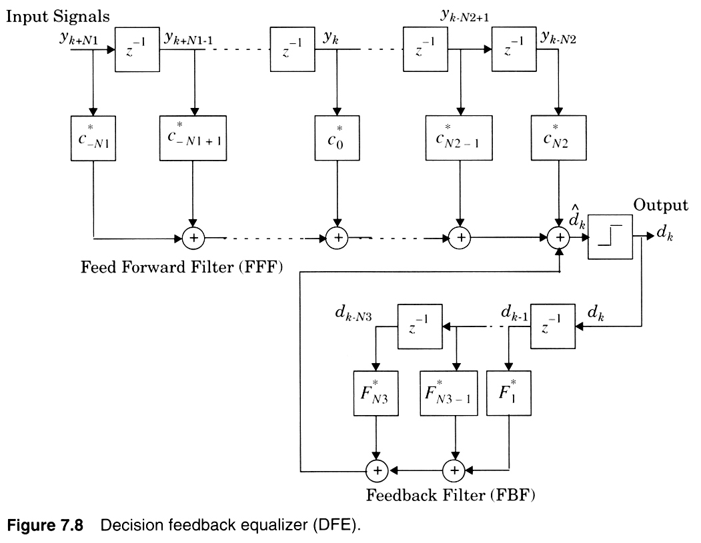
Notes:
Fig. 2.5

Slide 10
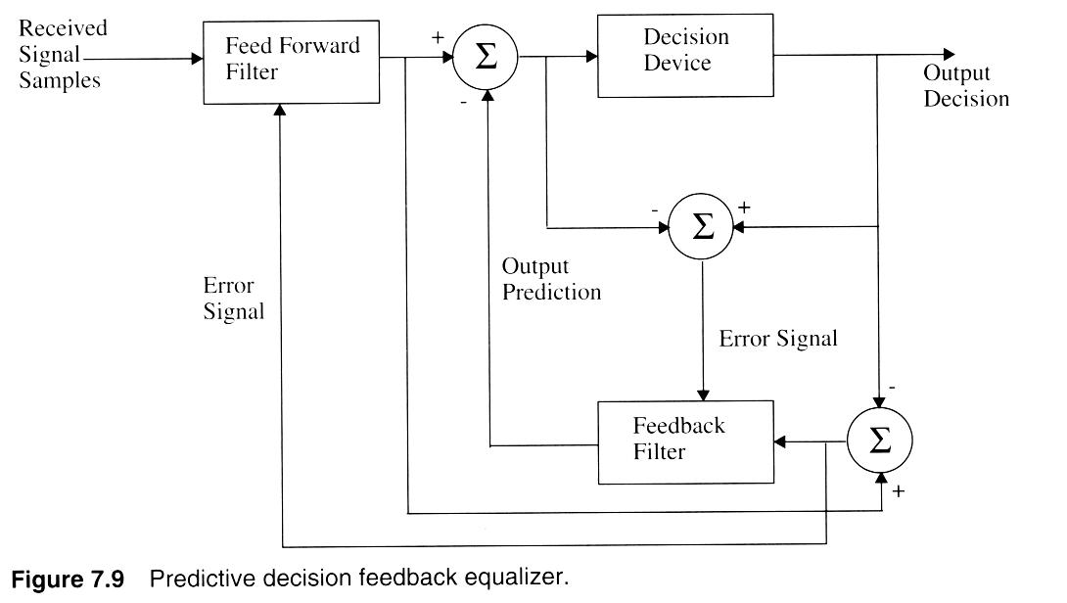
Notes:
Fig. 2.6

Slide 11
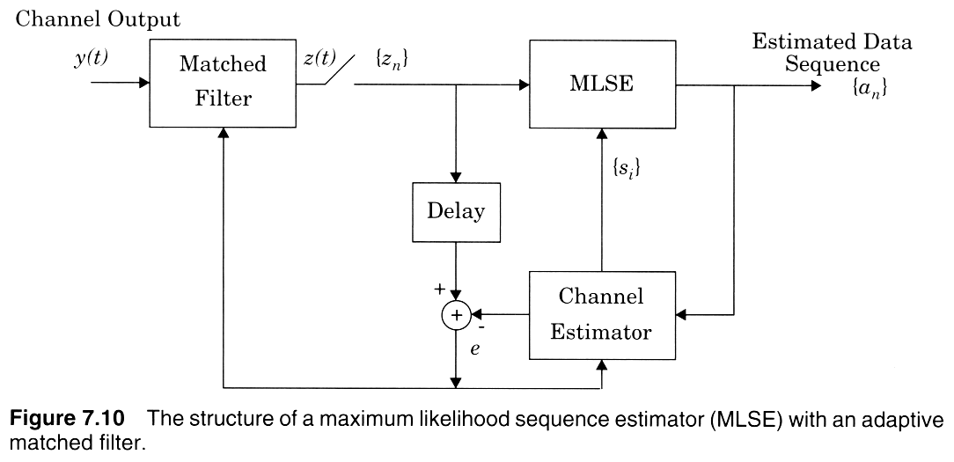
Notes:
Fig. 2.7

Slide 12
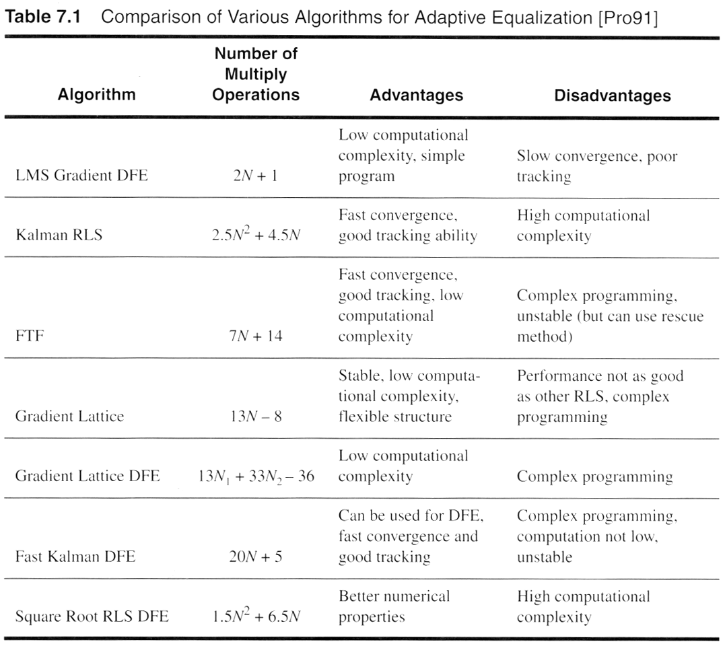
Notes:
Fig. 2.16

Slide 13
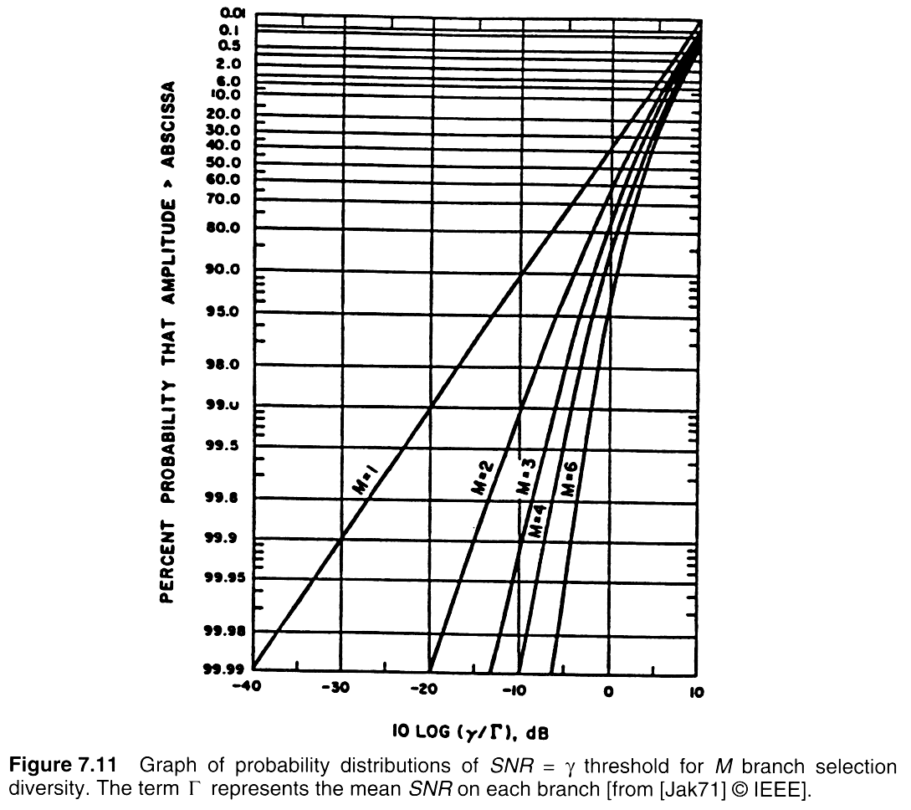
Notes:
Fig. 2.8

Slide 14
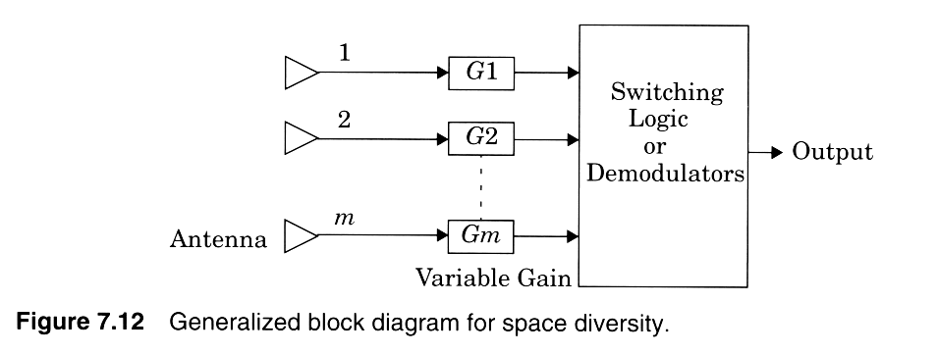
Notes:
Fig. 2.9

Slide 15
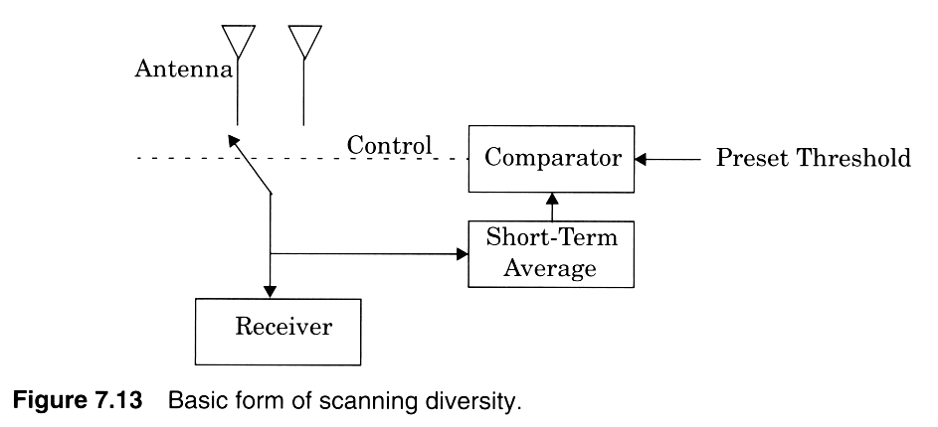
Notes:
Fig. 2.10

Slide 16
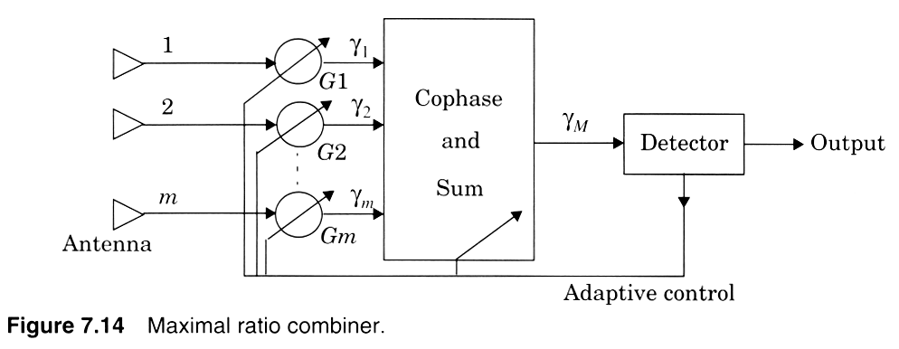
Notes:
Fig. 2.11

Slide 17
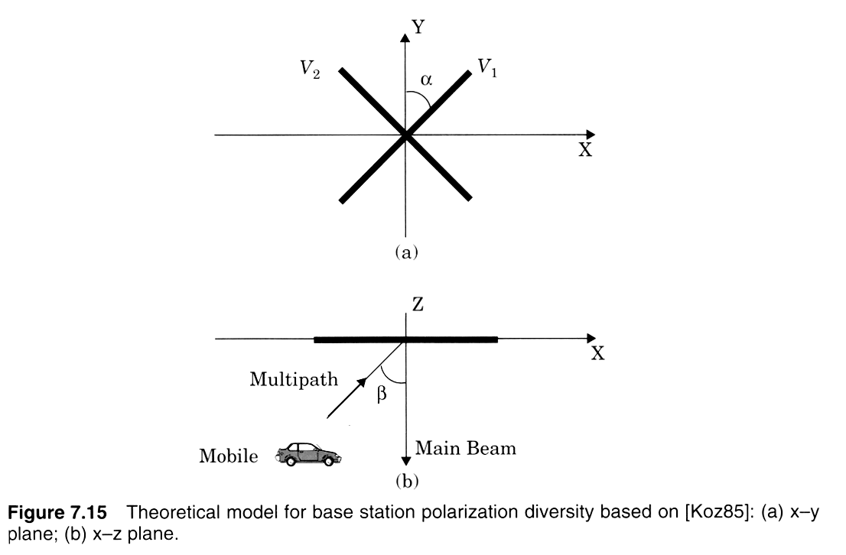
Notes:
Fig. 2.12

Slide 18
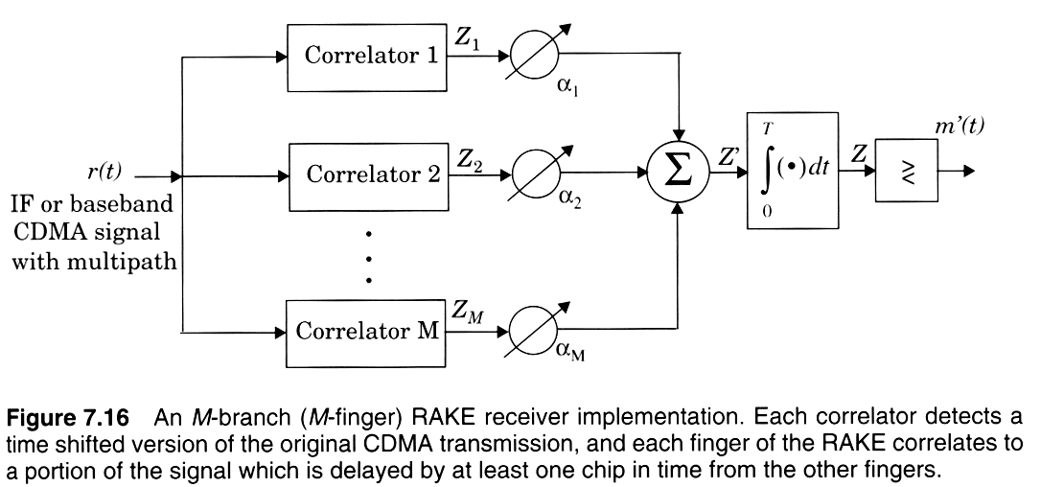
Notes:
Fig. 2.13

Slide 19
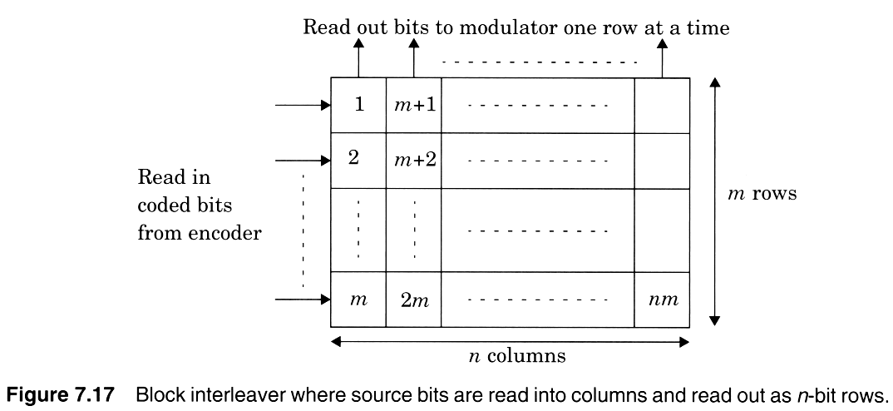
Notes:
Fig. 2.14

Slide 20
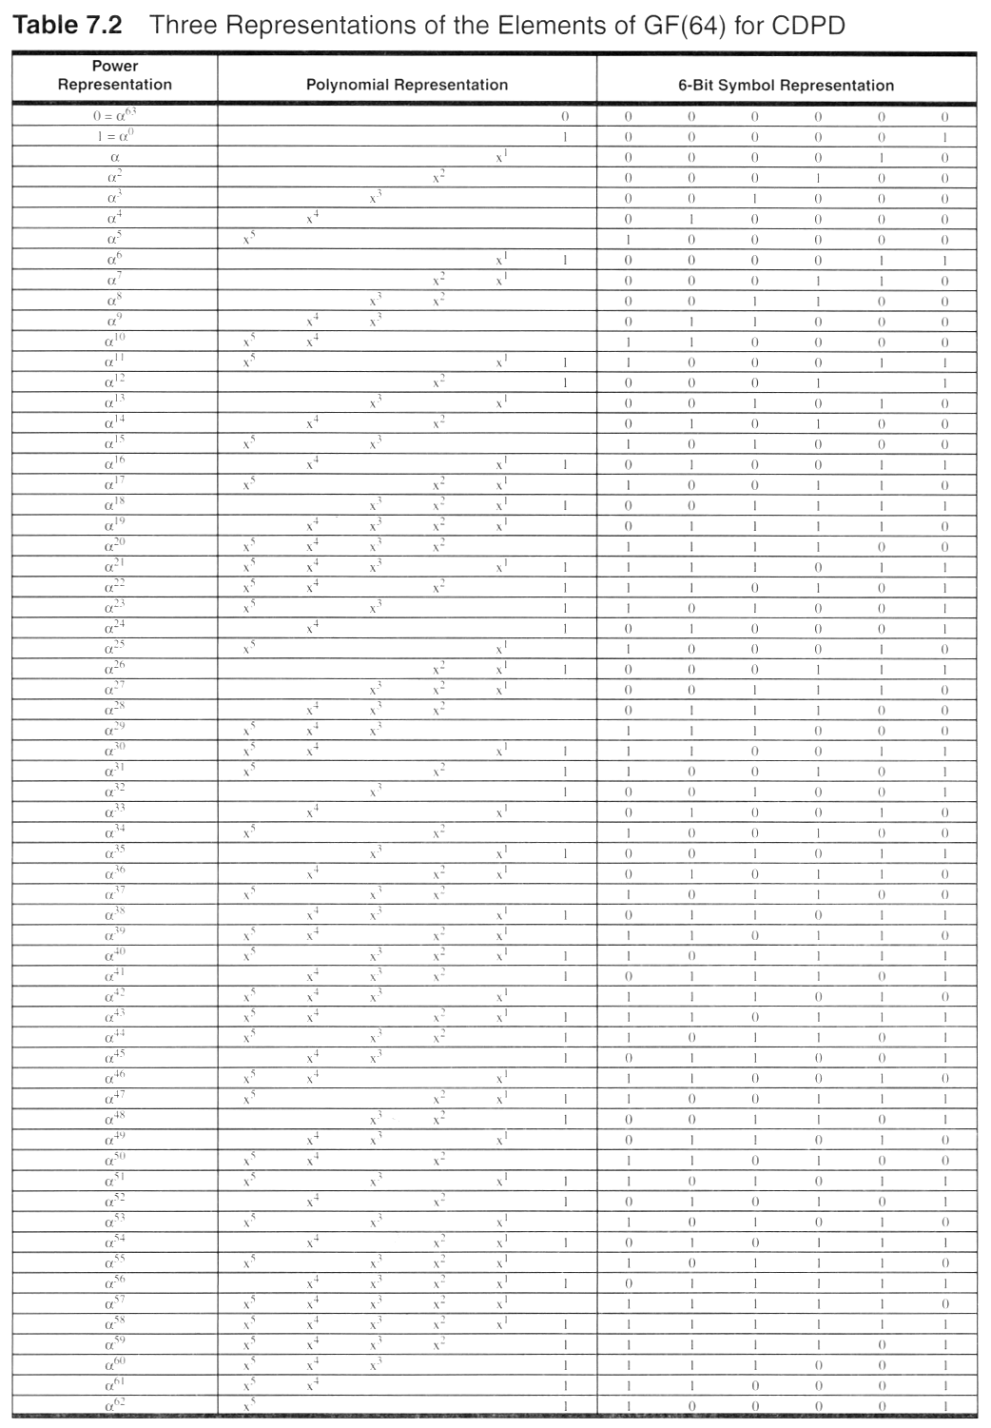
Notes:
Fig. 2.16

Slide 21
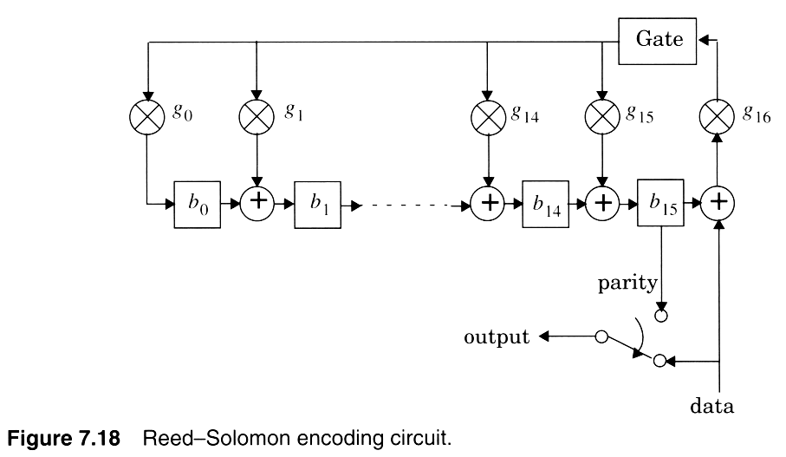
Notes:
Fig. 2.15

Slide 22
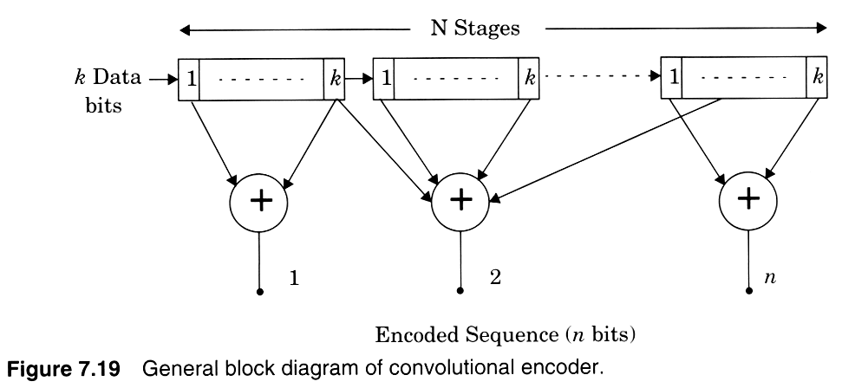
Notes:
Fig. 2.16

